Slide 1
You’ve got questions, but need data!
Accessing trait data from TRY, BIEN, and other sources

Slide 2
There are a number of great trait databases (and datasets) available
Many journals (and even governments!) are making it mandatory to publish data
New open source repositories are making it easier than ever to access this data
Let’s talk about a few databases/sets (that may be useful for your projects)…

Slide 3
Databases (multiple combined datasets)

Slide 4

The TRY plant traits database
https://www.try-db.org/TryWeb/Home.php
6.9 million records
148,000 plants

Slide 5
TRY
Pros
Lots of data!
Can separate by species and/or traits
Cons
Data can hard to sort through
Data access is kind of a pain
Not all data is openly available

Slide 6

The Botanical Information and Ecology Network (BIEN)
http://bien.nceas.ucsb.edu/bien/
206 million records
486,000 plants

Slide 7
BIEN
Pros
Tons of data
Data can be accessed via an R package or web interface
Lots of great tools on the BIEN website!
Cons
Data is mostly occurrence
Not as many traits a TRY

Slide 8
Fine-Root Ecology Database (FRED)
https://roots.ornl.gov/
105,000 records
300 root traits

Slide 9
FRED
Pros
Lots of data on roots
Good spatial coverage
Seems easily accessible
Cons
Only roots

Slide 10
Datasets

Slide 11
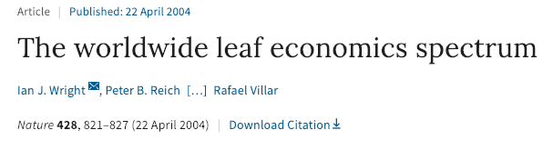
GLOPNET
https://www.nature.com/articles/nature02403#supplementary-information
2,600 records
All leaf traits (SLA, nutrients, and gas exchange)

Slide 12
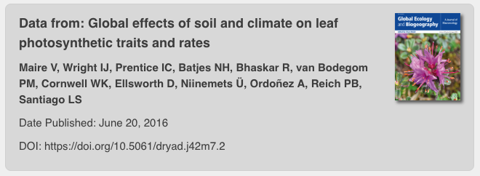
Maire et al. (2016)
https://datadryad.org/resource/doi:10.5061/dryad.j42m7
2,400 records
All leaf traits (SLA, nutrients, and gas exchange)
Also includes climate and soil data

Slide 13
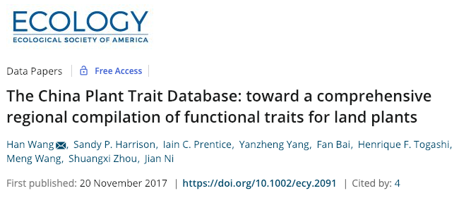
China Plant Traits Database
https://esajournals.onlinelibrary.wiley.com/doi/full/10.1002/ecy.2091
1,215 species
All leaf traits (SLA, nutrients, and gas exchange)
Boreal - tropical

